Slide 1
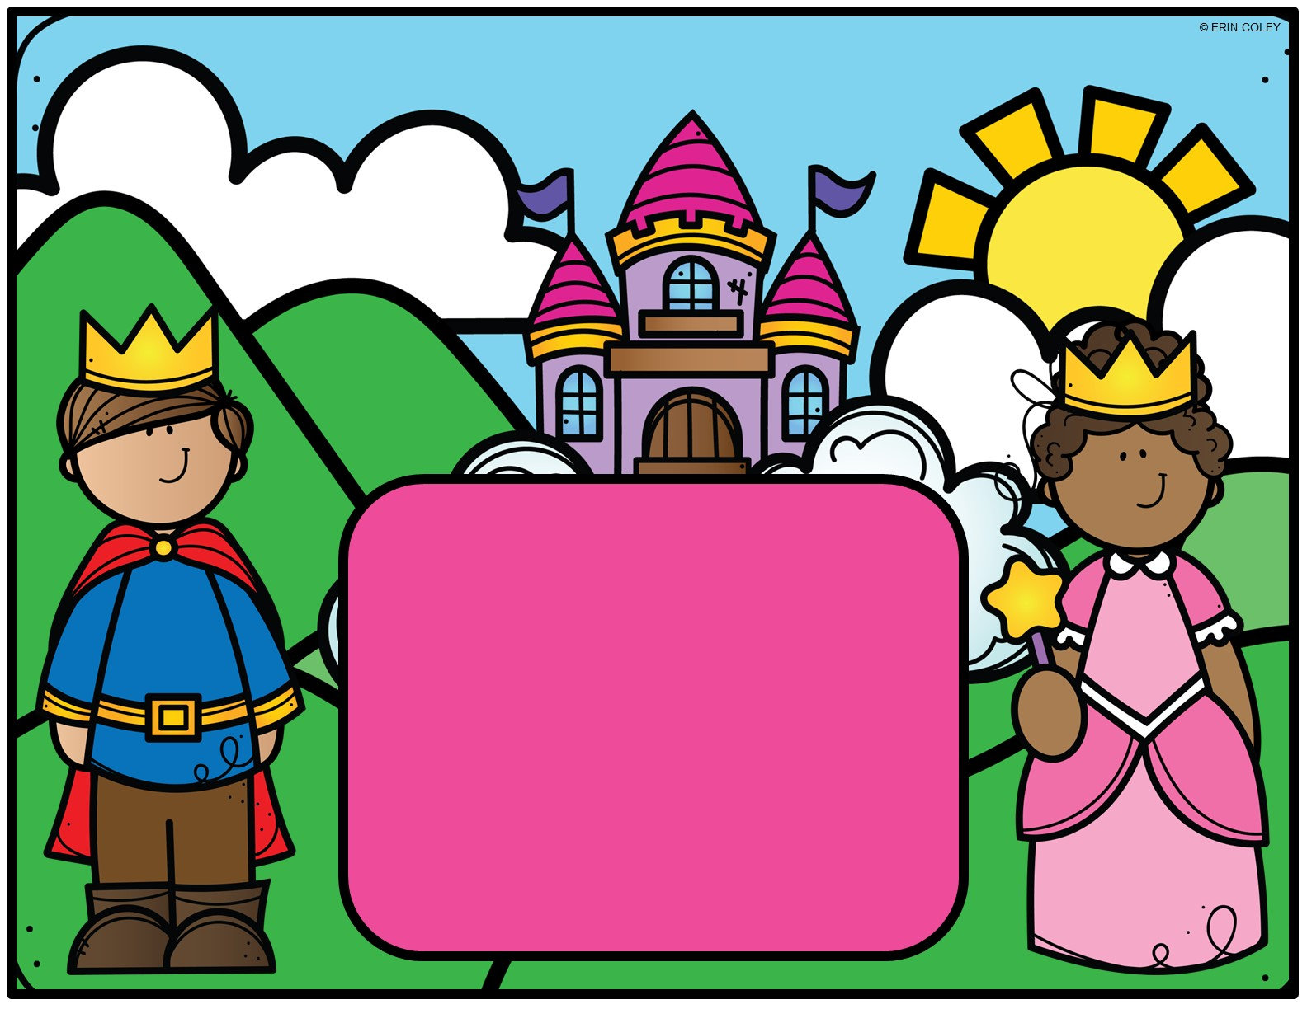
Fairy Town is in danger of a dragon takeover! The only person who can help is the reclusive wizard, Caspian of the Mystic Forest. Prince Louie and Princess Val are on a quest to find the mysterious wizard. They’ll encounter some obstacles along the way – as well as some helping hands! Can you help Prince Louie and Princess Val find Caspian and save Fairy Town?

Slide 2
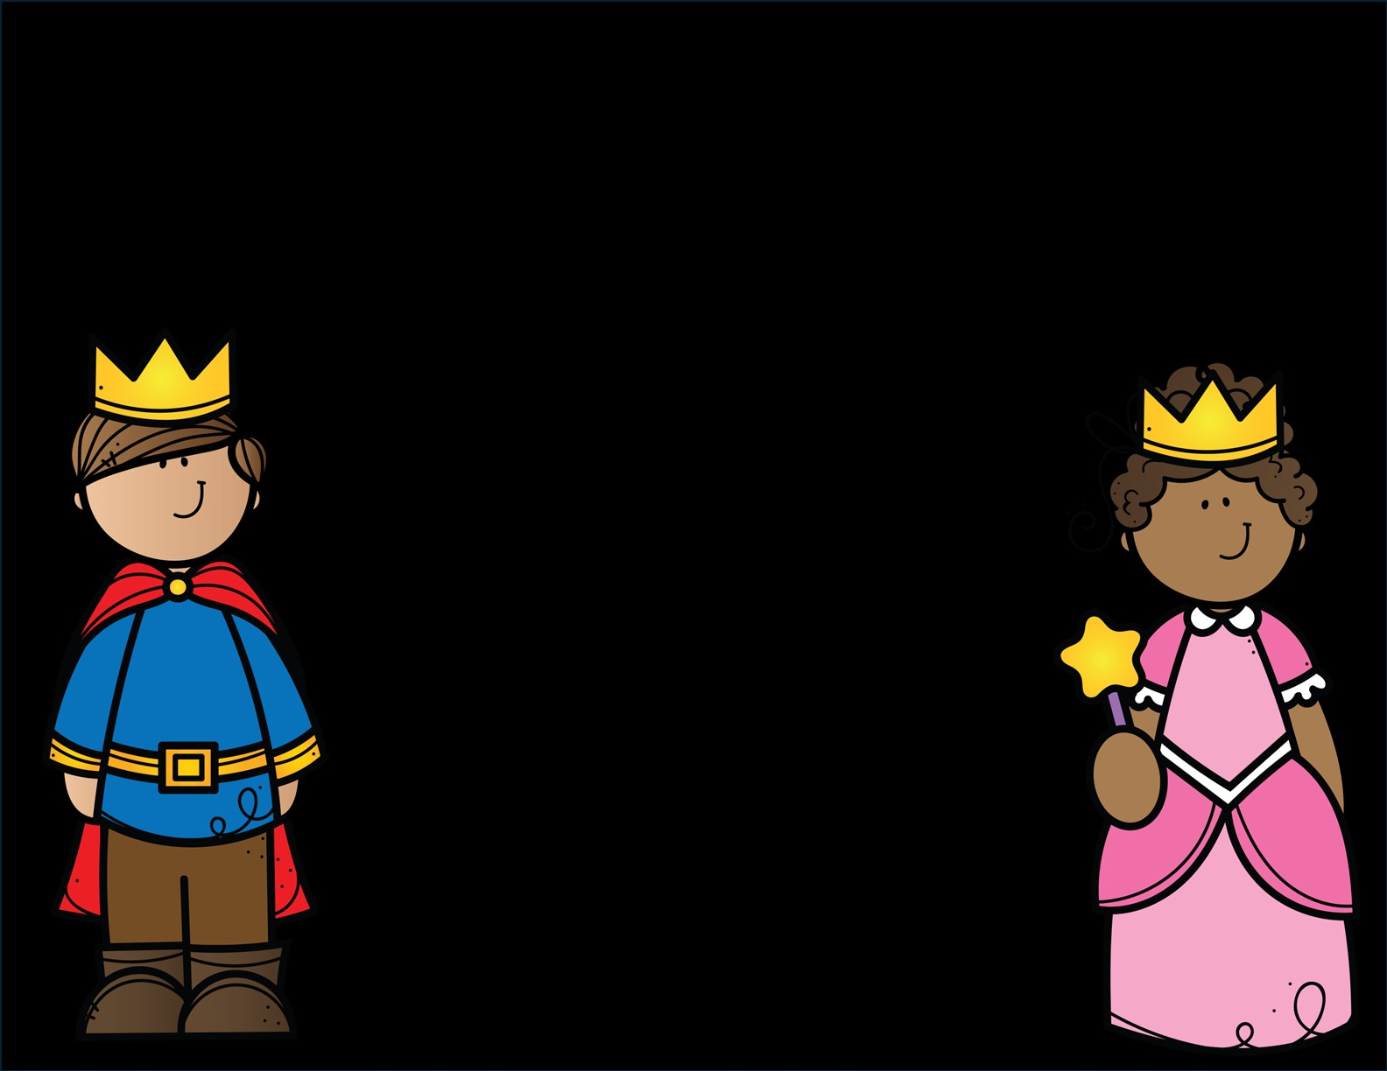
READY
SET
GO!

Slide 3
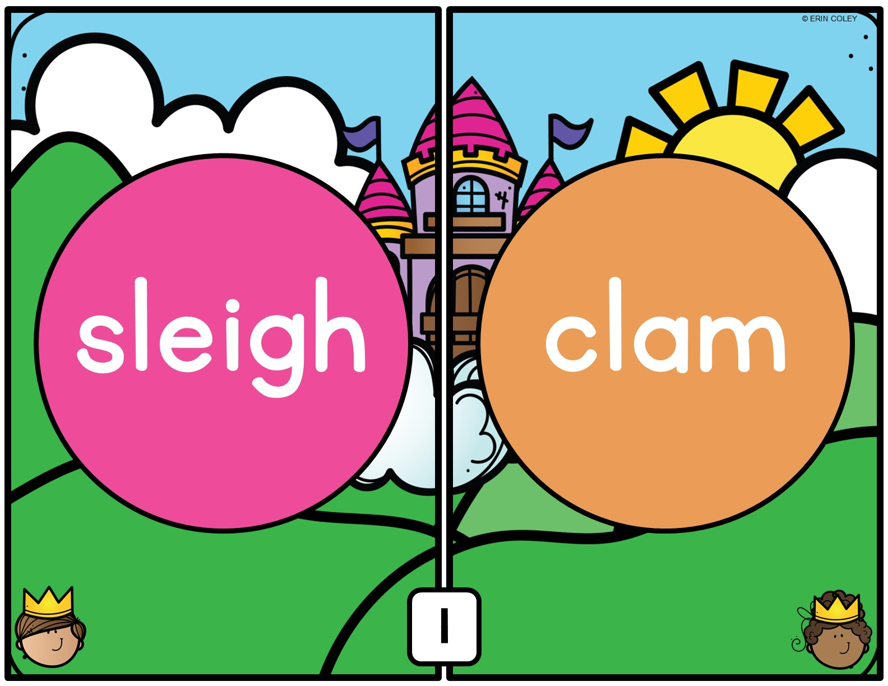

Slide 4
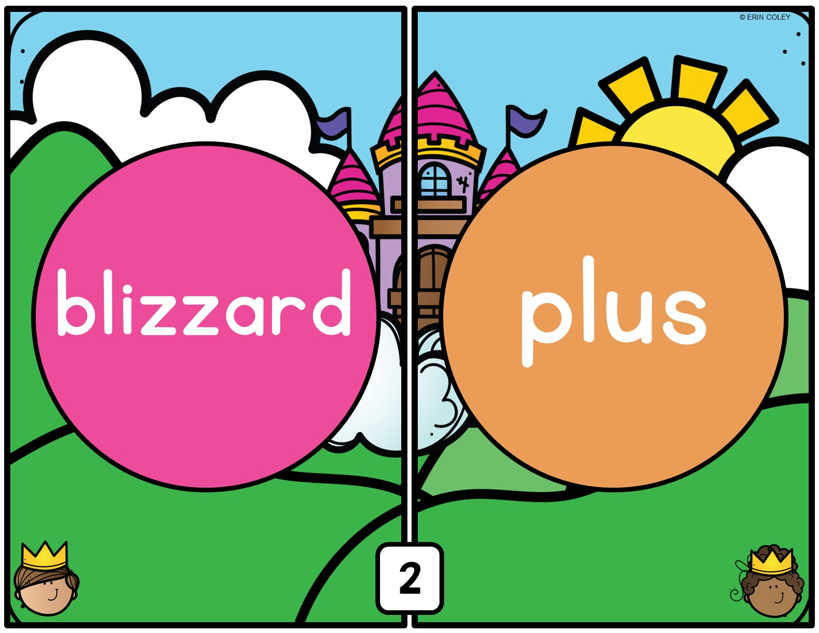

Slide 5
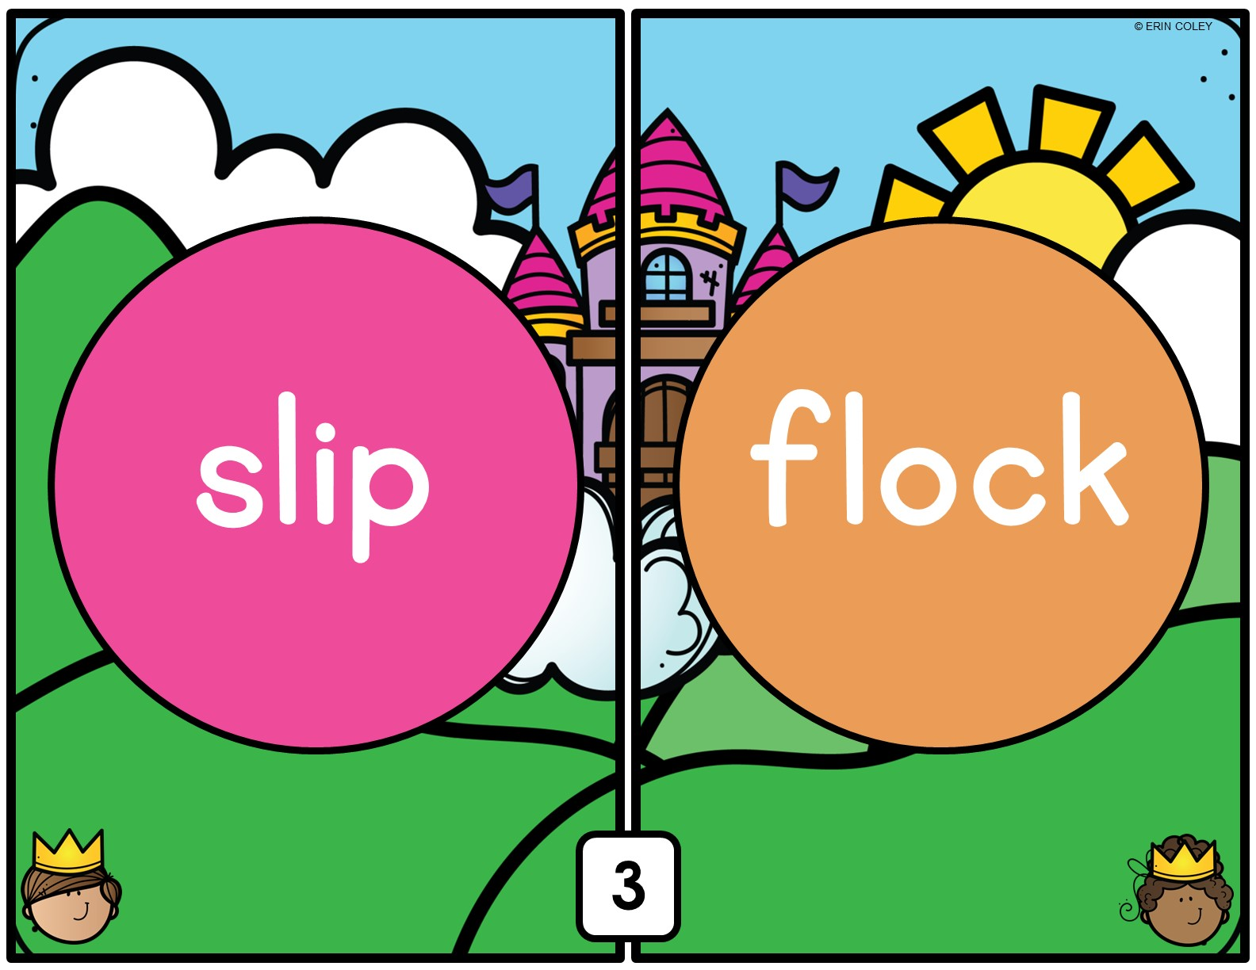

Slide 6
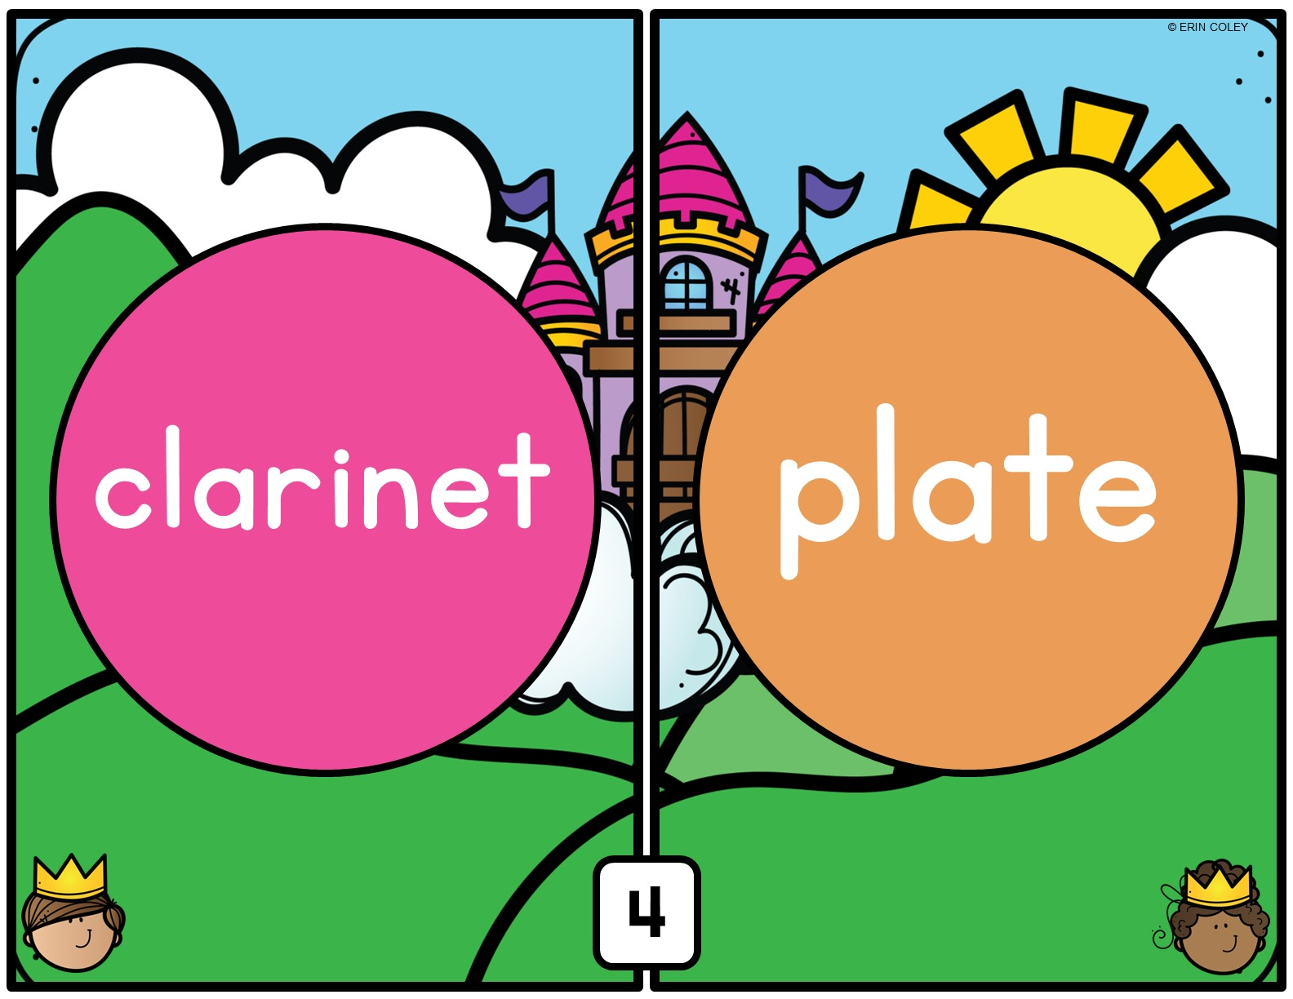

Slide 7
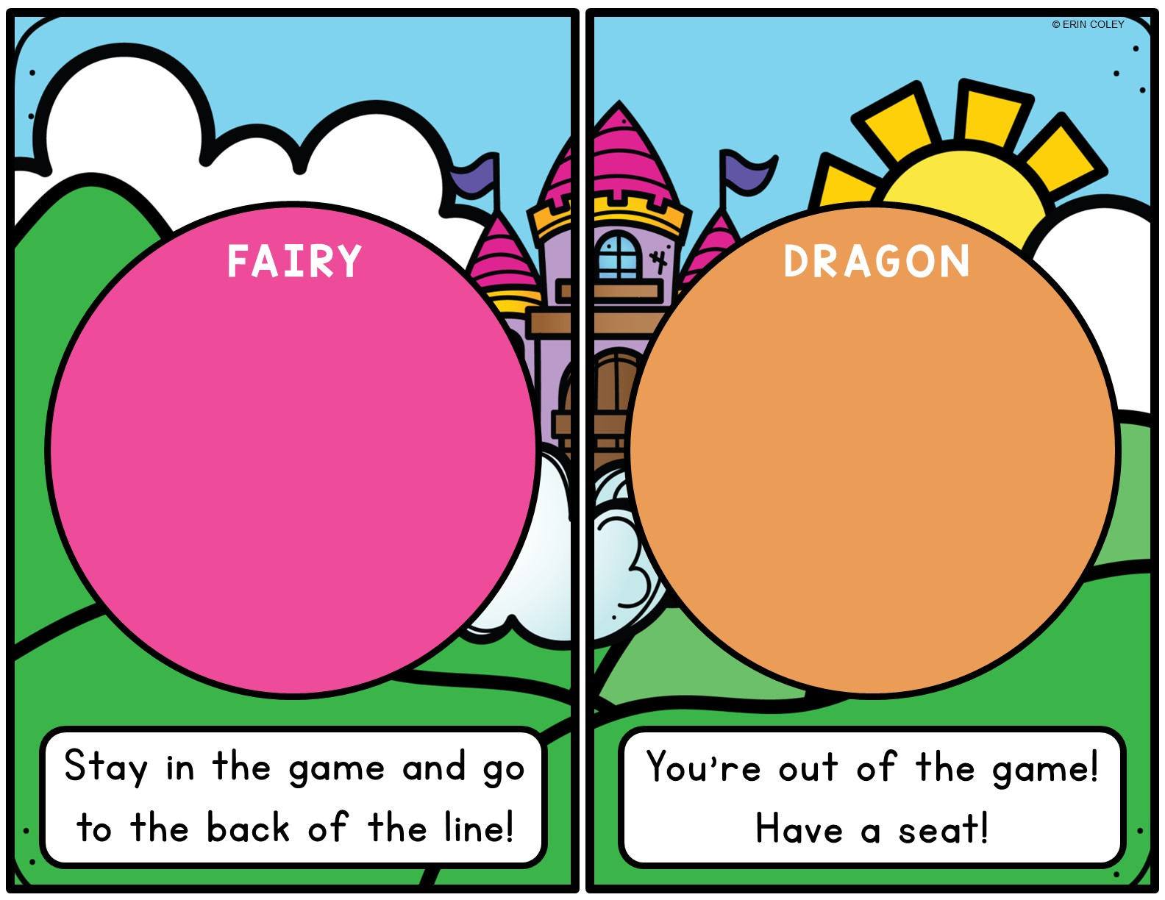



Slide 8
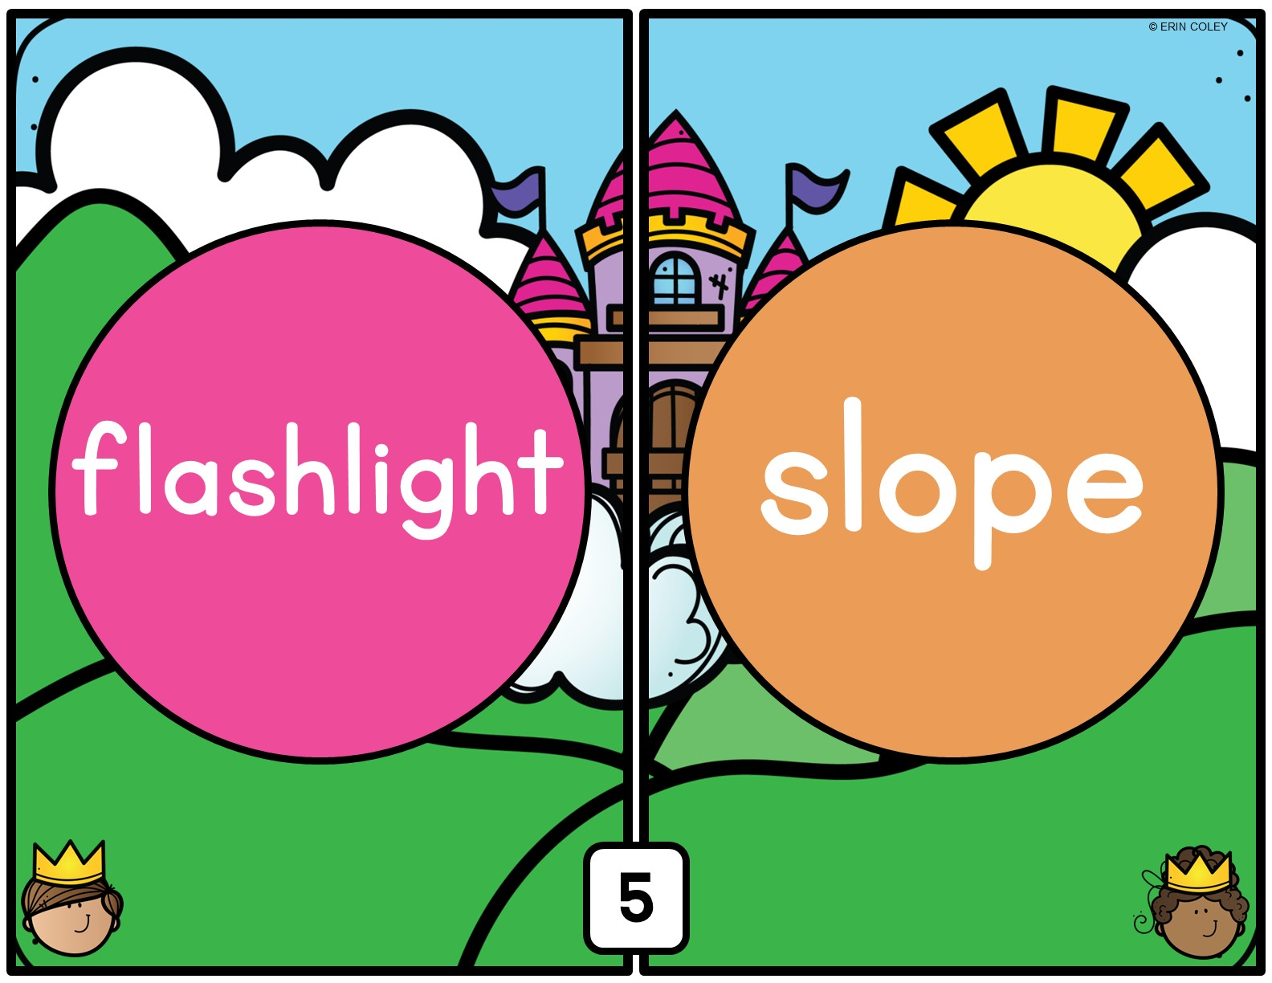

Slide 9


Slide 10
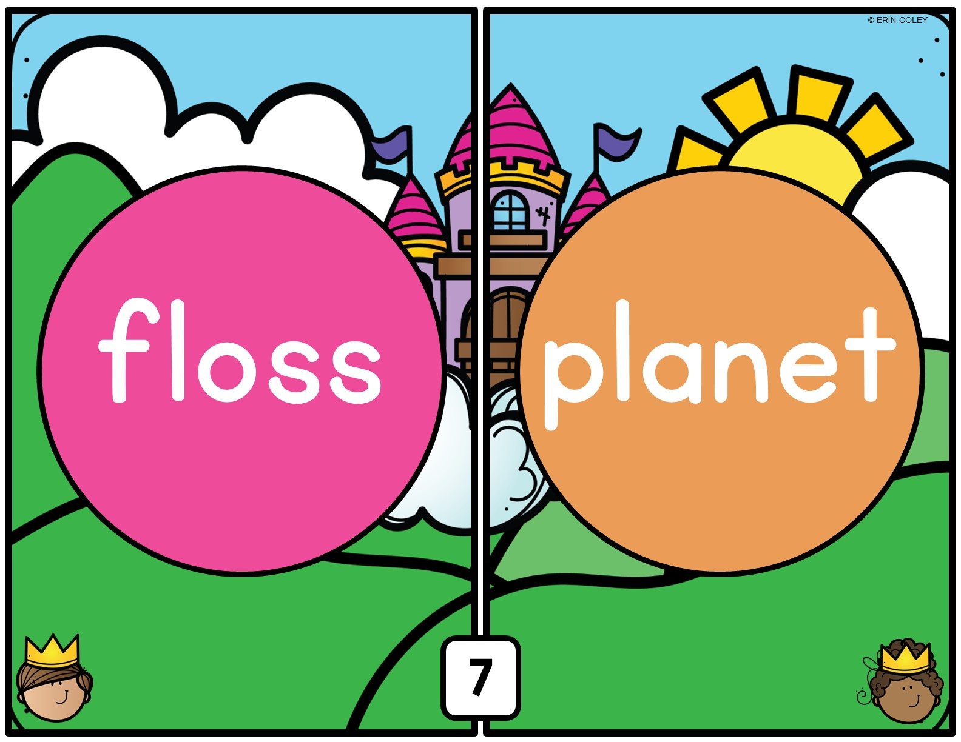

Slide 11
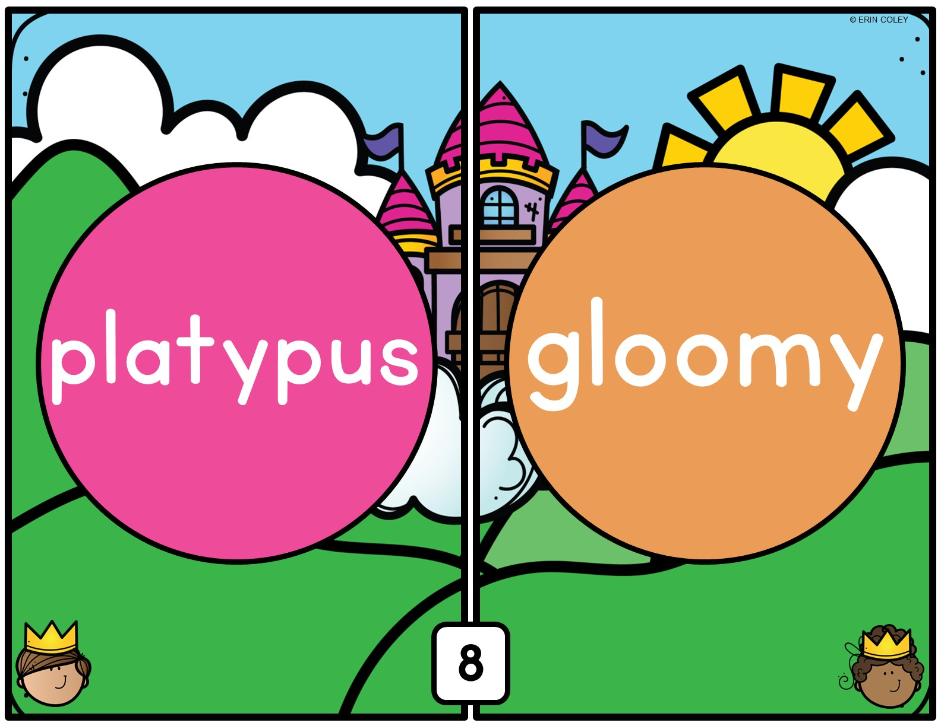

Slide 12
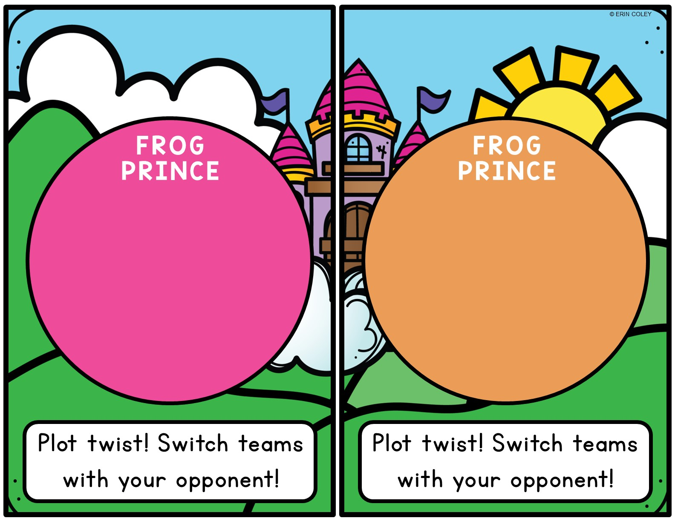


Slide 13
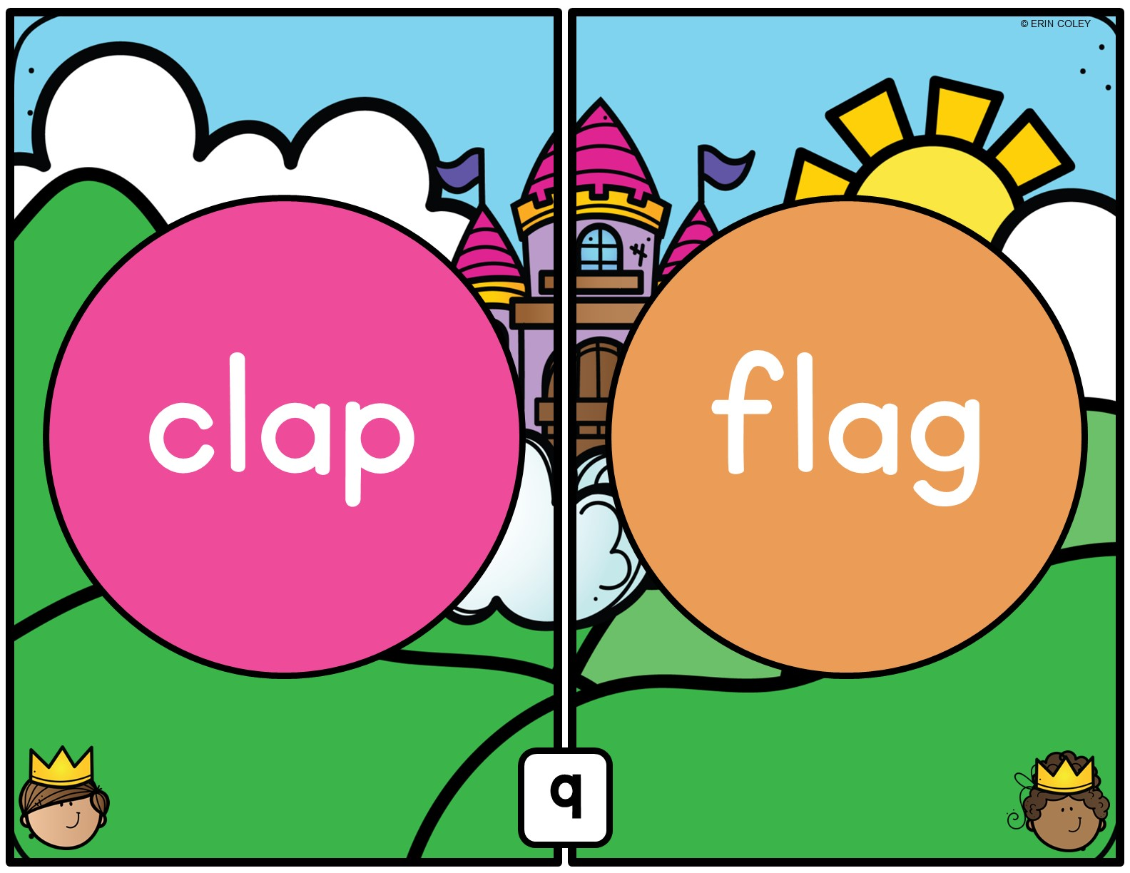

Slide 14
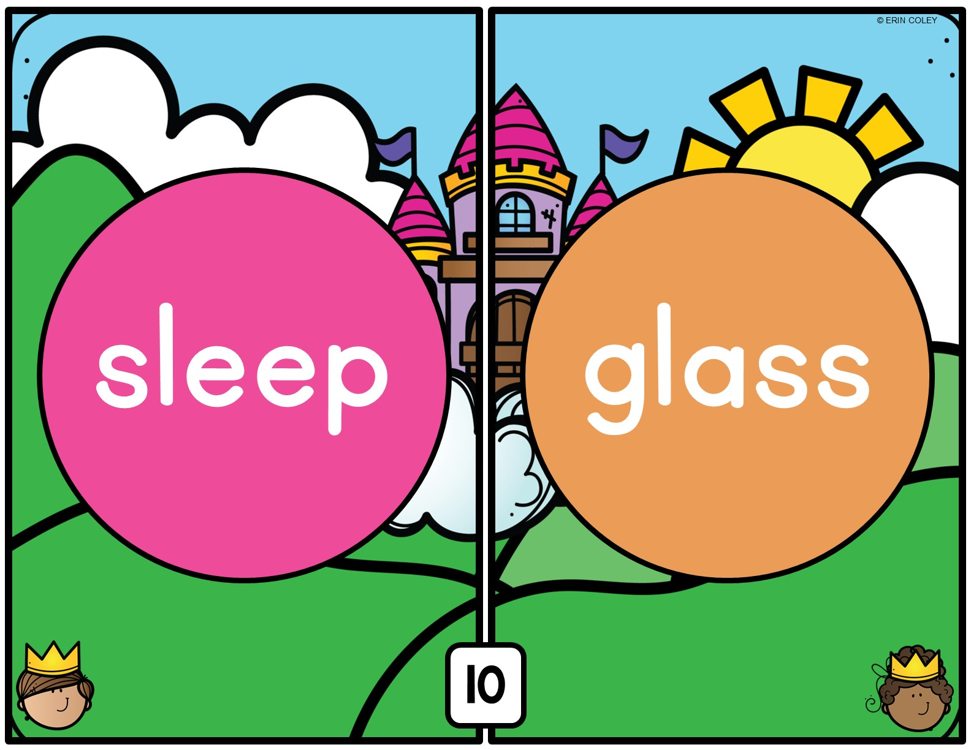

Slide 15
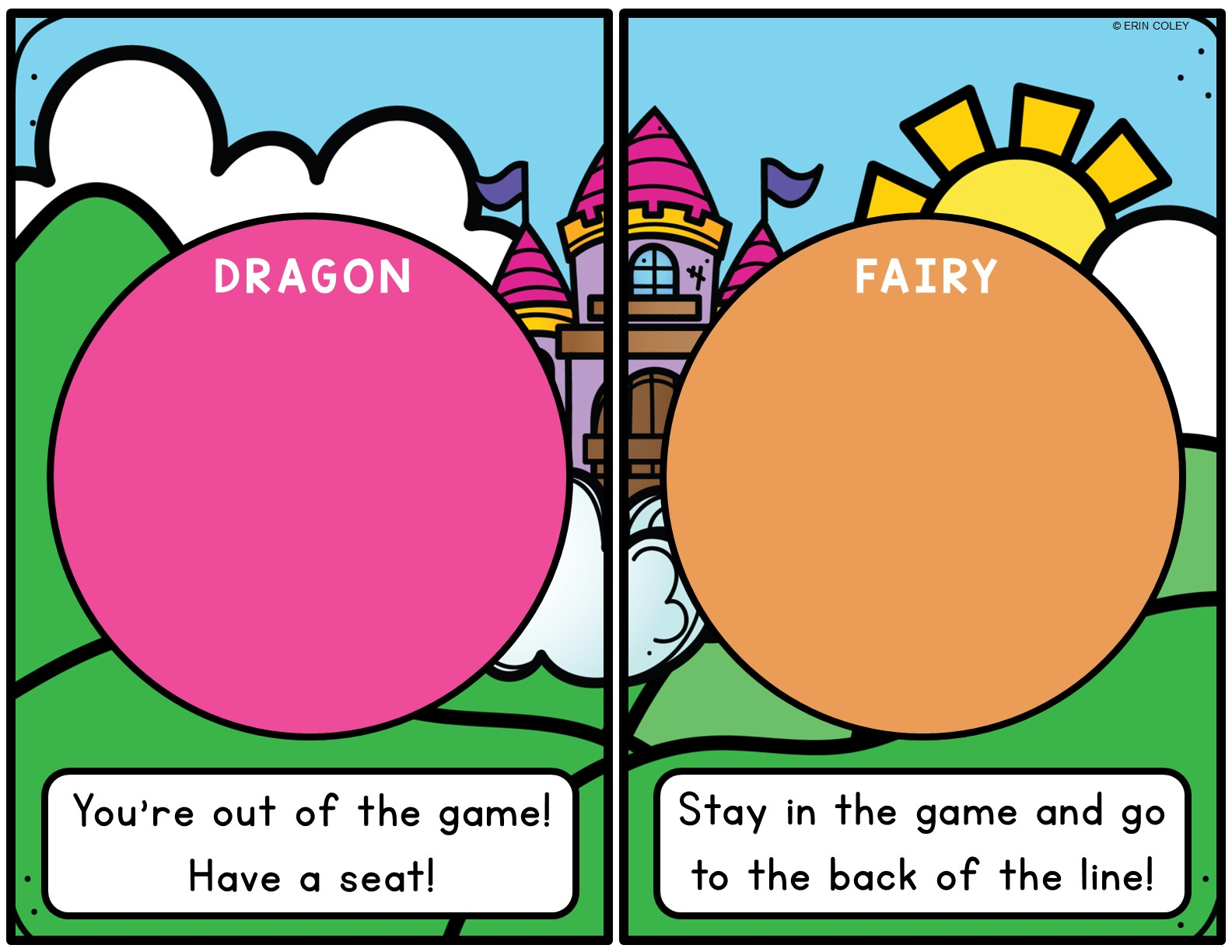


Slide 16


Slide 17


Slide 18
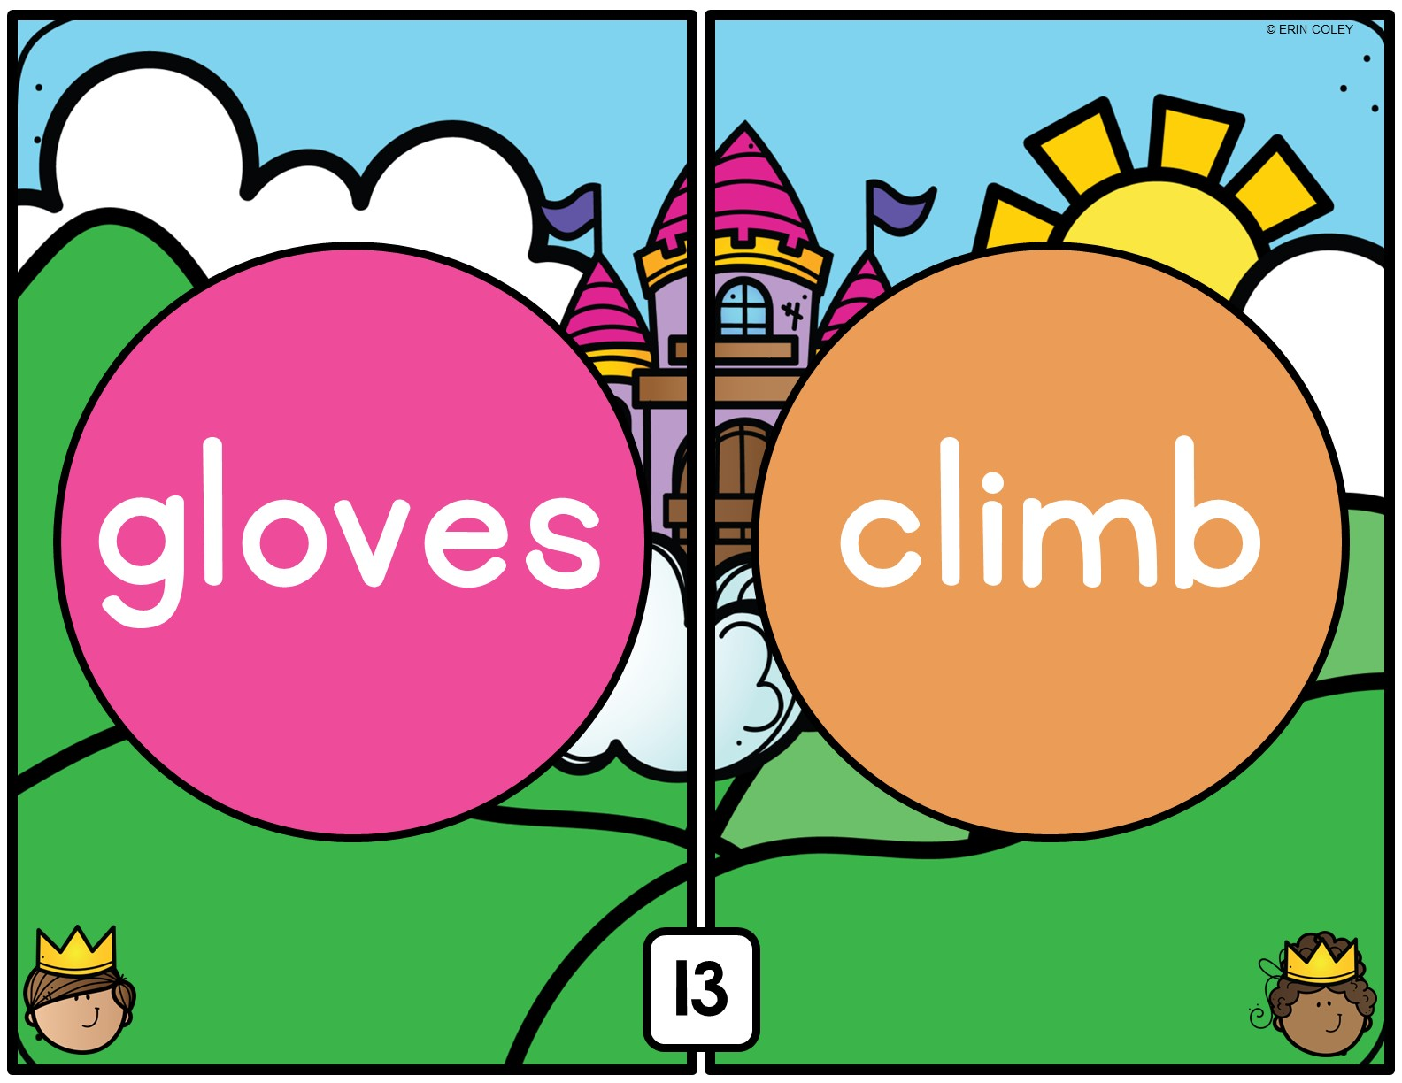

Slide 19


Slide 20
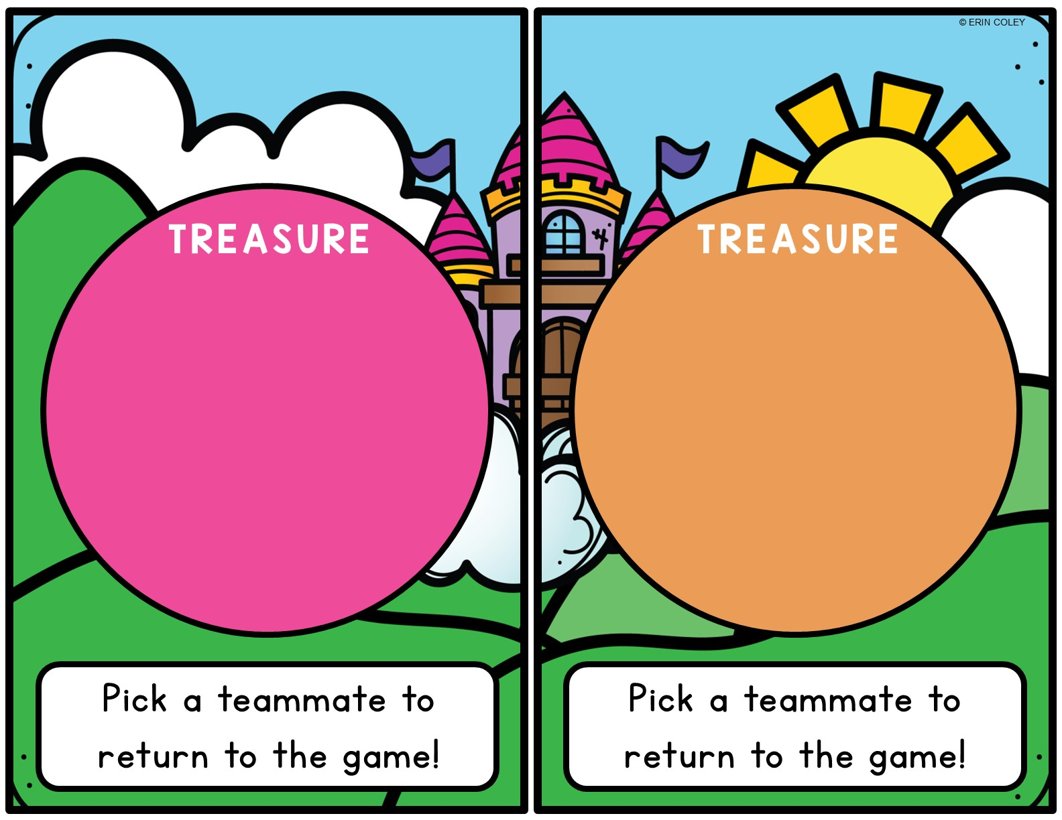


Slide 21


Slide 22


Slide 24


Slide 25
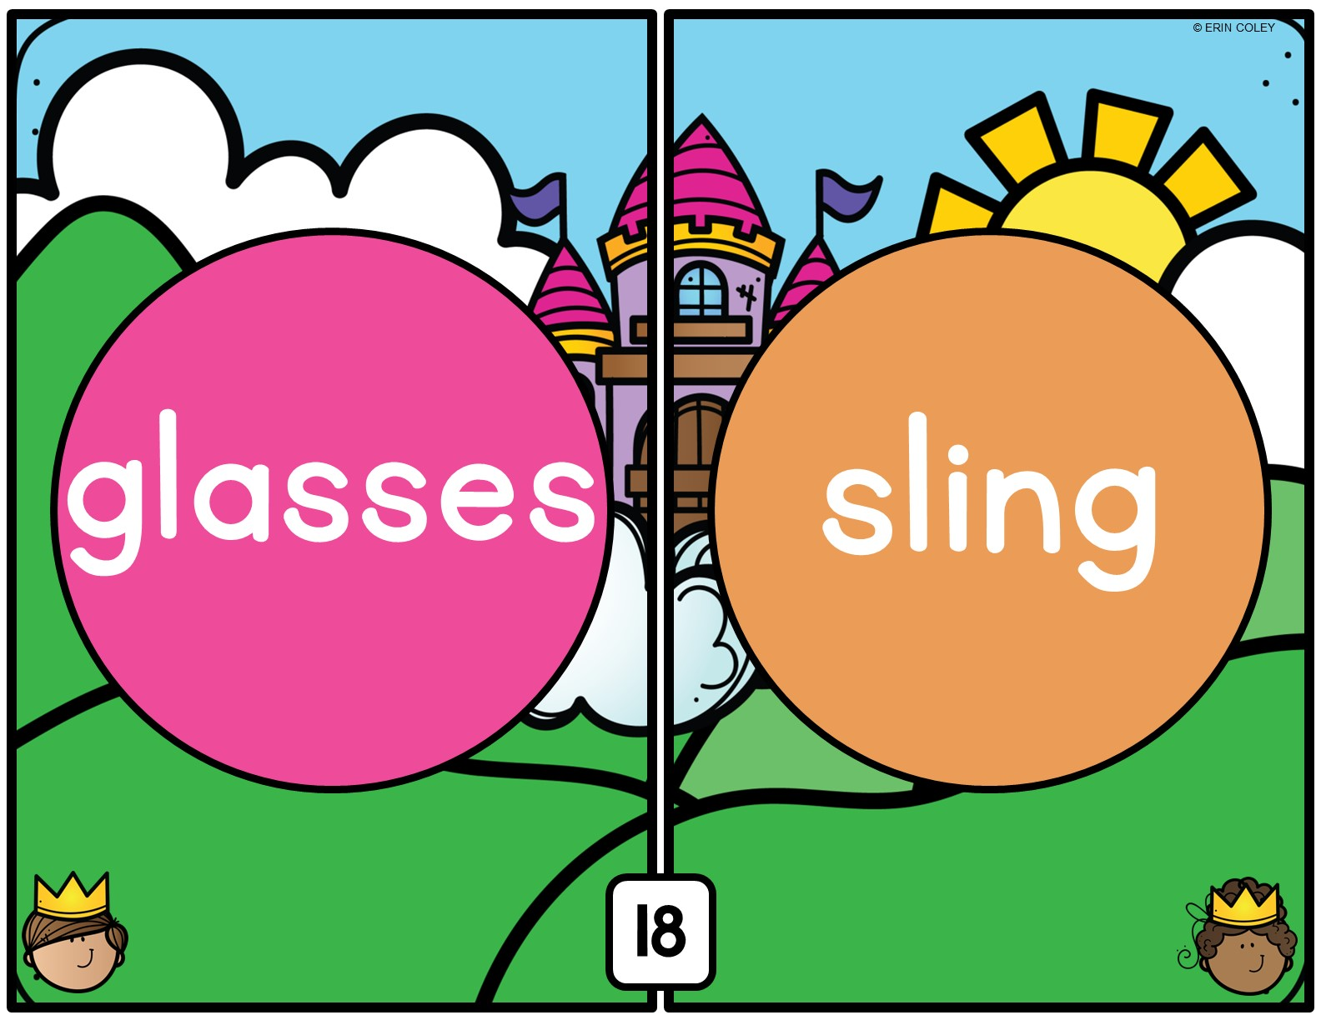

Slide 26


Slide 27


Slide 28


Slide 29


Slide 30


Slide 31
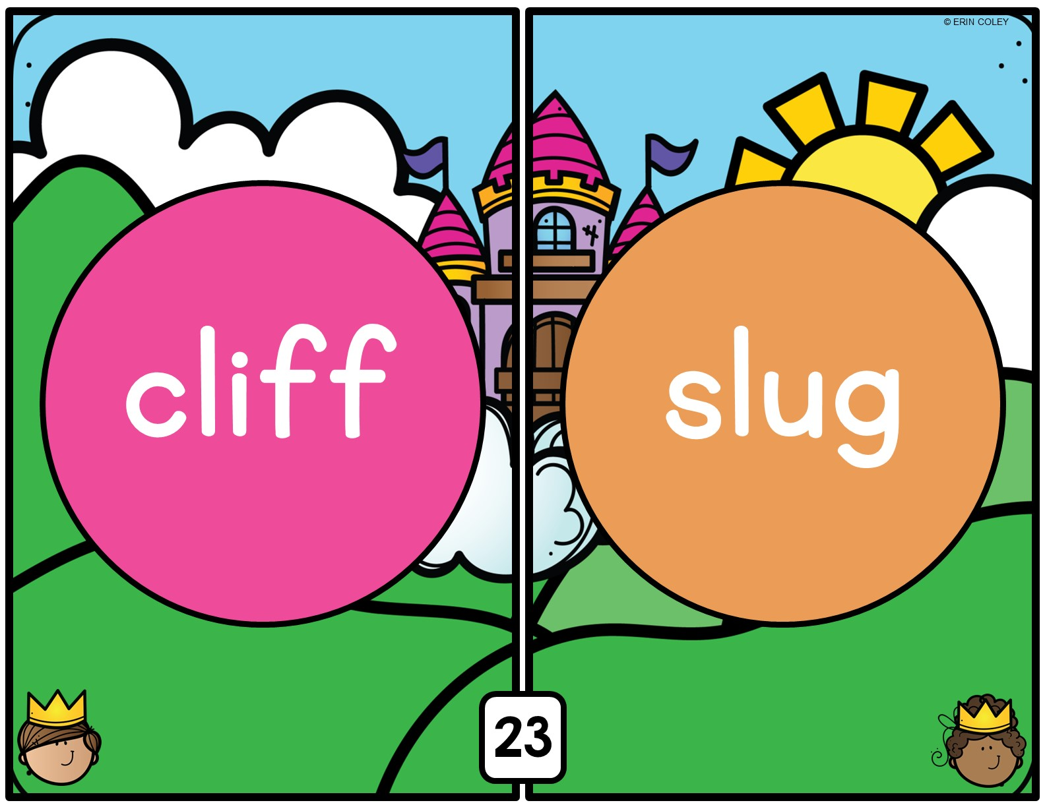

Slide 32


Slide 34


Slide 35
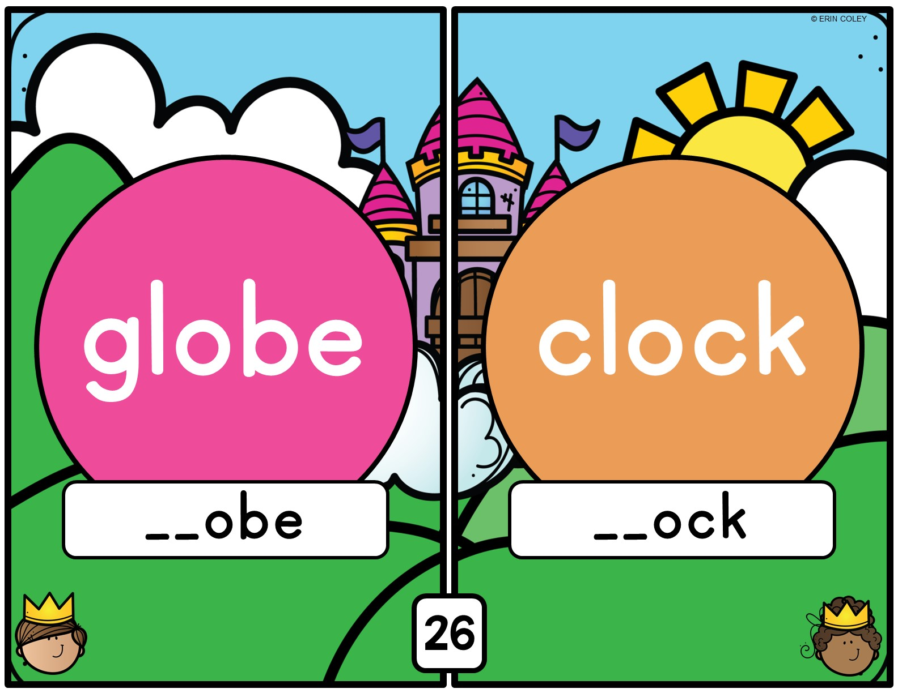

Slide 36


Slide 37
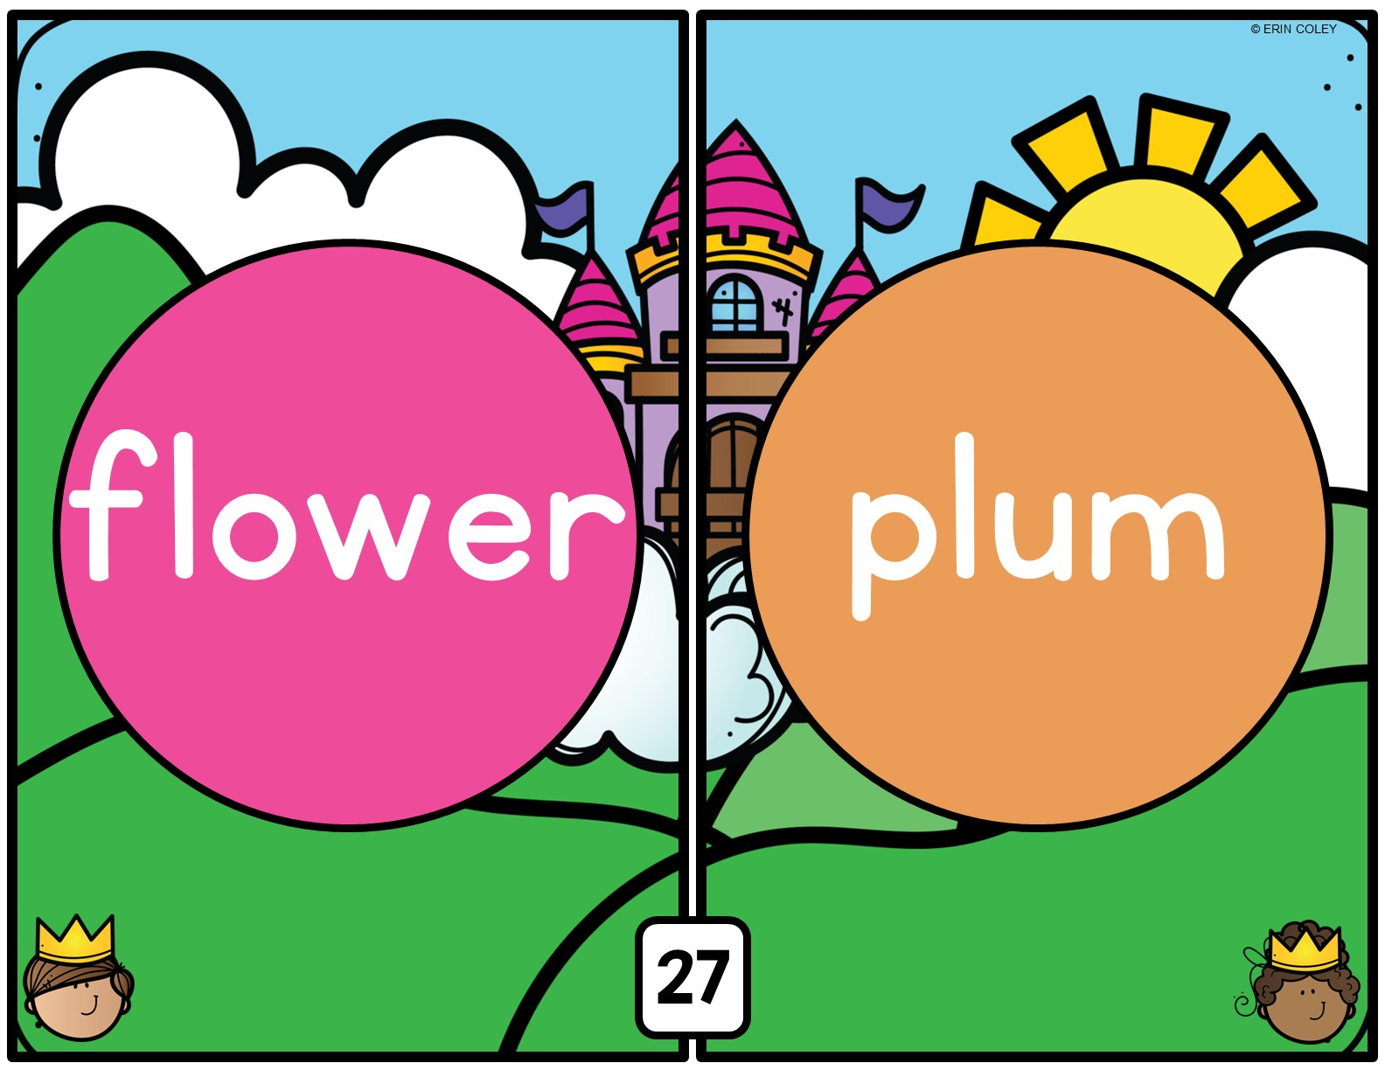

Slide 38
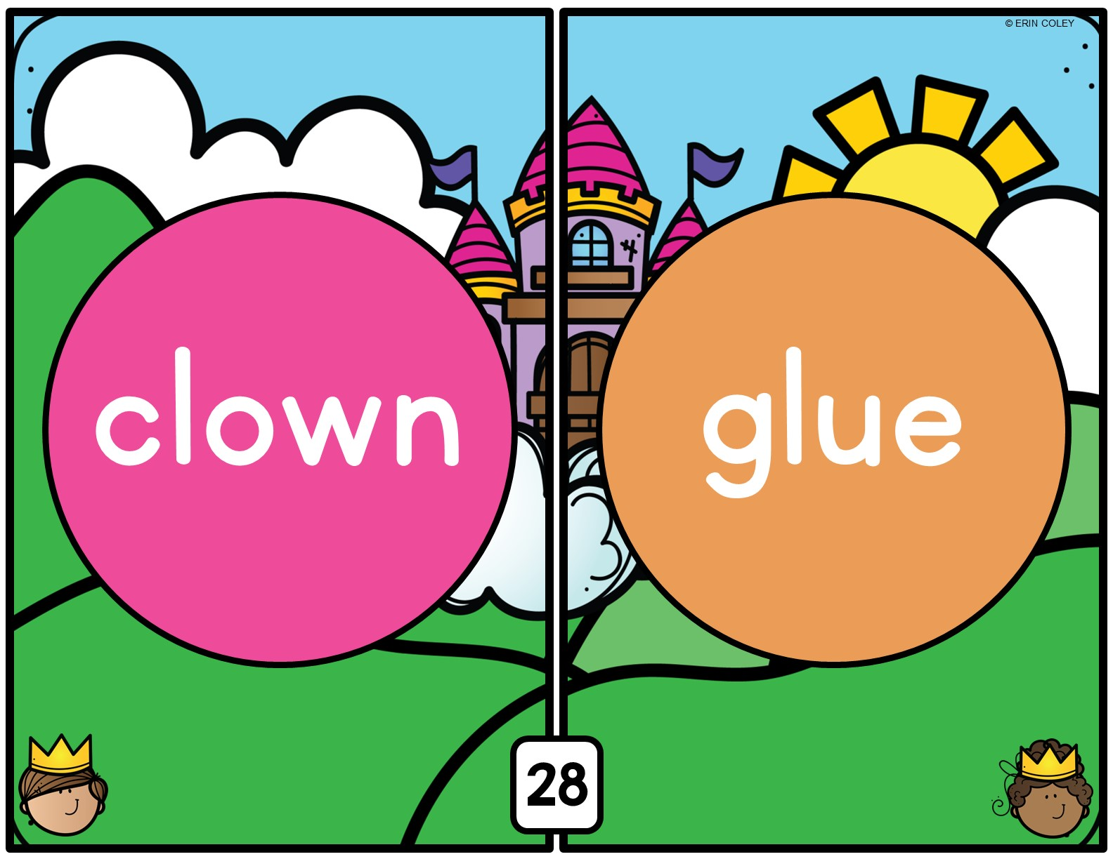

Slide 39
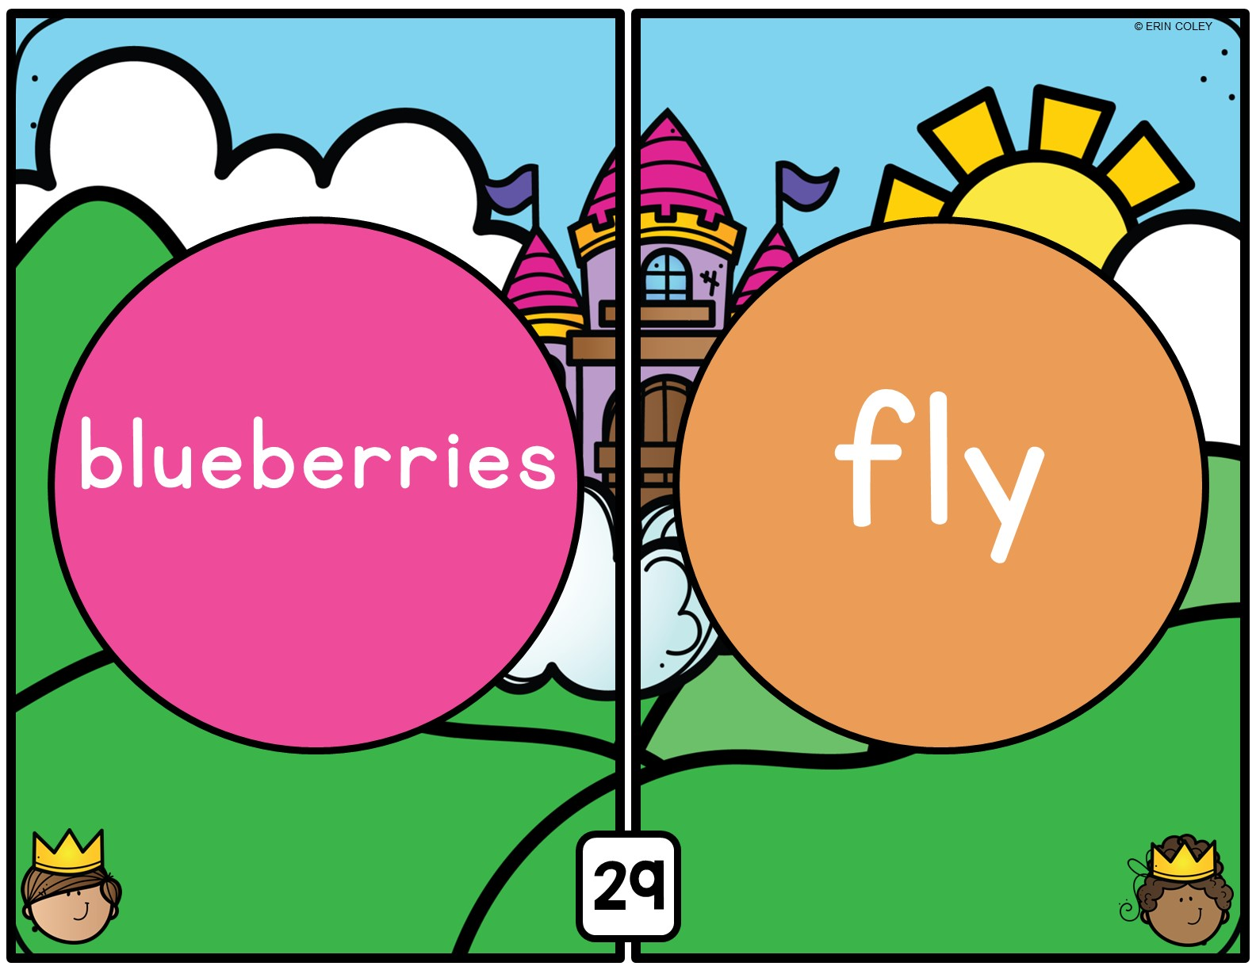

Slide 40


Slide 41
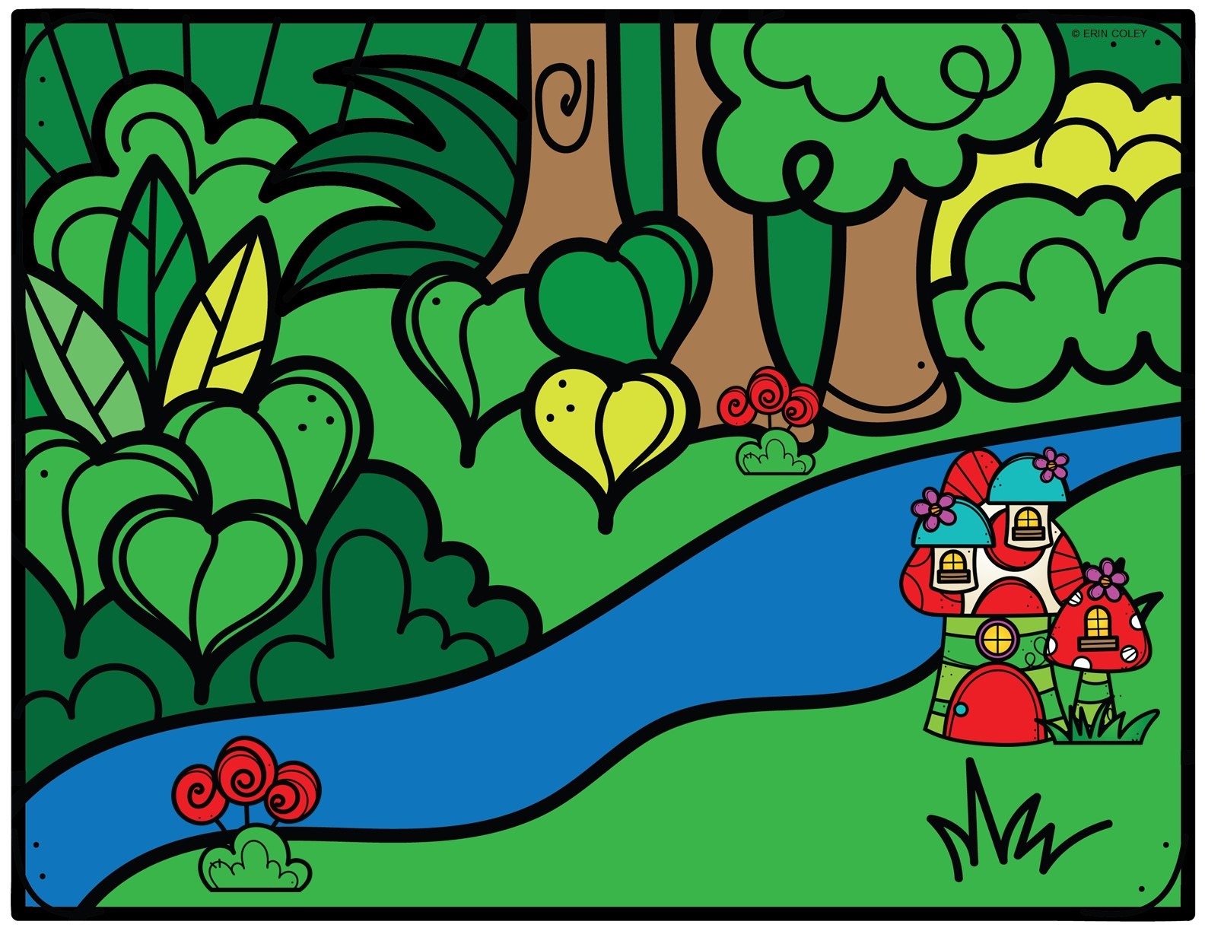




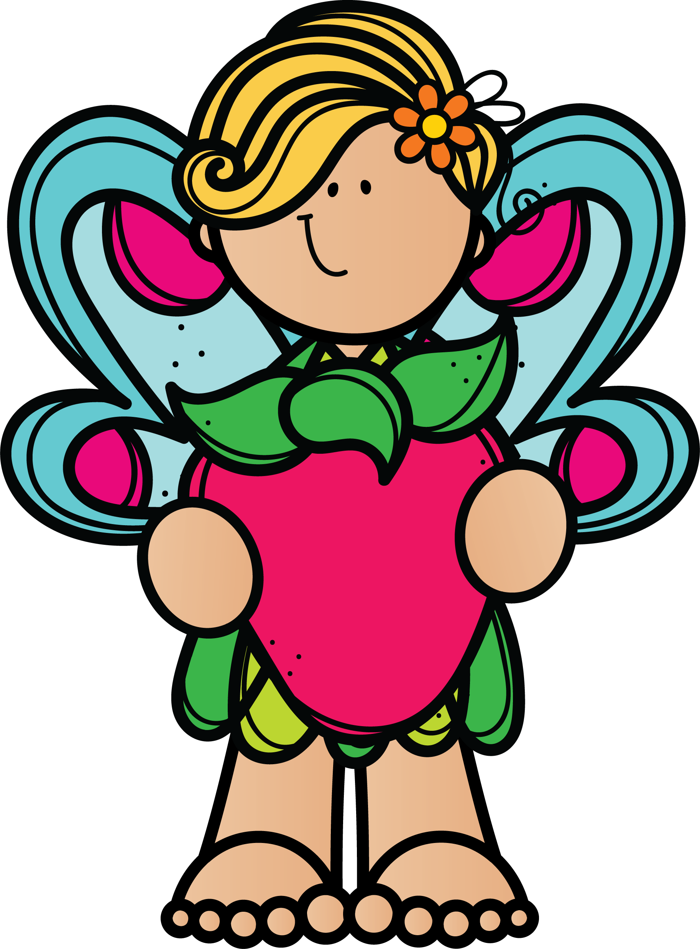
CONGRATULATIONS! YOU HAVE
HELPED FIND WIZARD CASPIAN OF MYSTIC FOREST & SAVEd FAIRY TOWN!

