Slide 1
Fairy Town is in danger of a dragon takeover! The only person who can help is the reclusive wizard, Caspian of the Mystic Forest. Prince Louie and Princess Val are on a quest to find the mysterious wizard. They’ll encounter some obstacles along the way – as well as some helping hands! Can you help Prince Louie and Princess Val find Caspian and save Fairy Town?

Slide 2
READY
SET
GO!

Slide 41
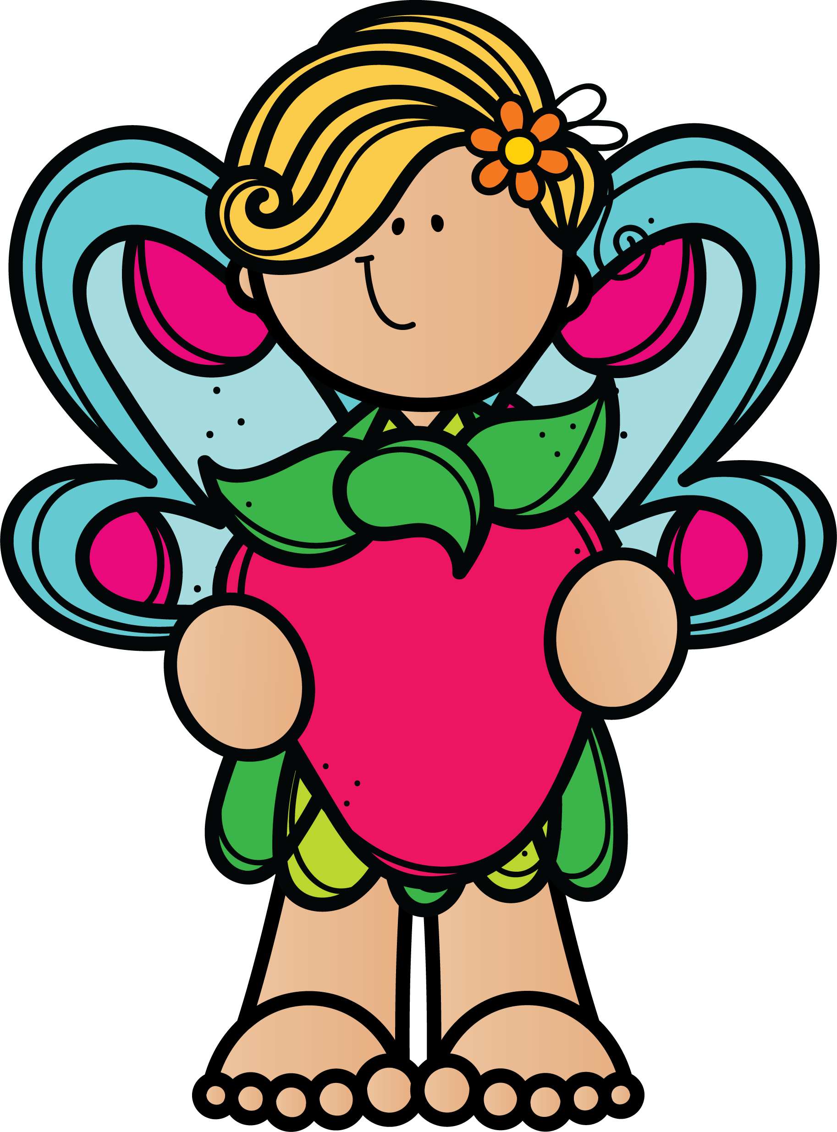
CONGRATULATIONS! YOU HAVE
HELPED FIND WIZARD CASPIAN OF MYSTIC FOREST & SAVEd FAIRY TOWN!

