Slide 1


Slide 2
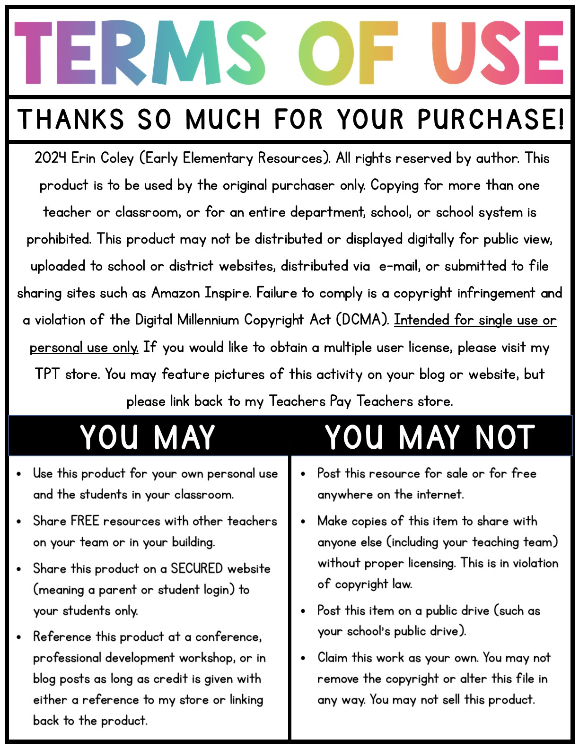

Slide 3

READ TO SELF

Slide 4

READING FLUENCY

Slide 5

READING CENTER

Slide 6

PARTNER READING

Slide 7
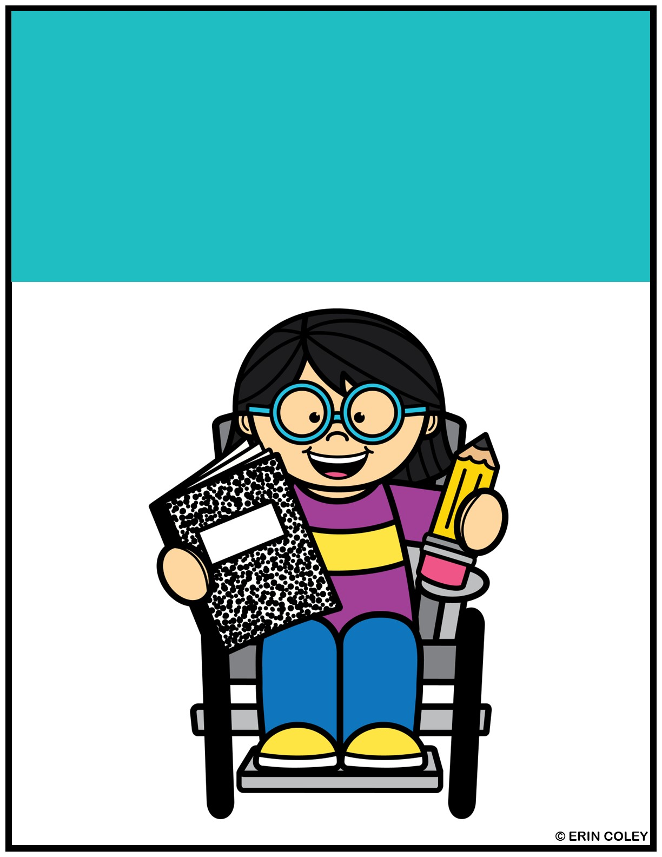
WORK ON WRITING

Slide 8
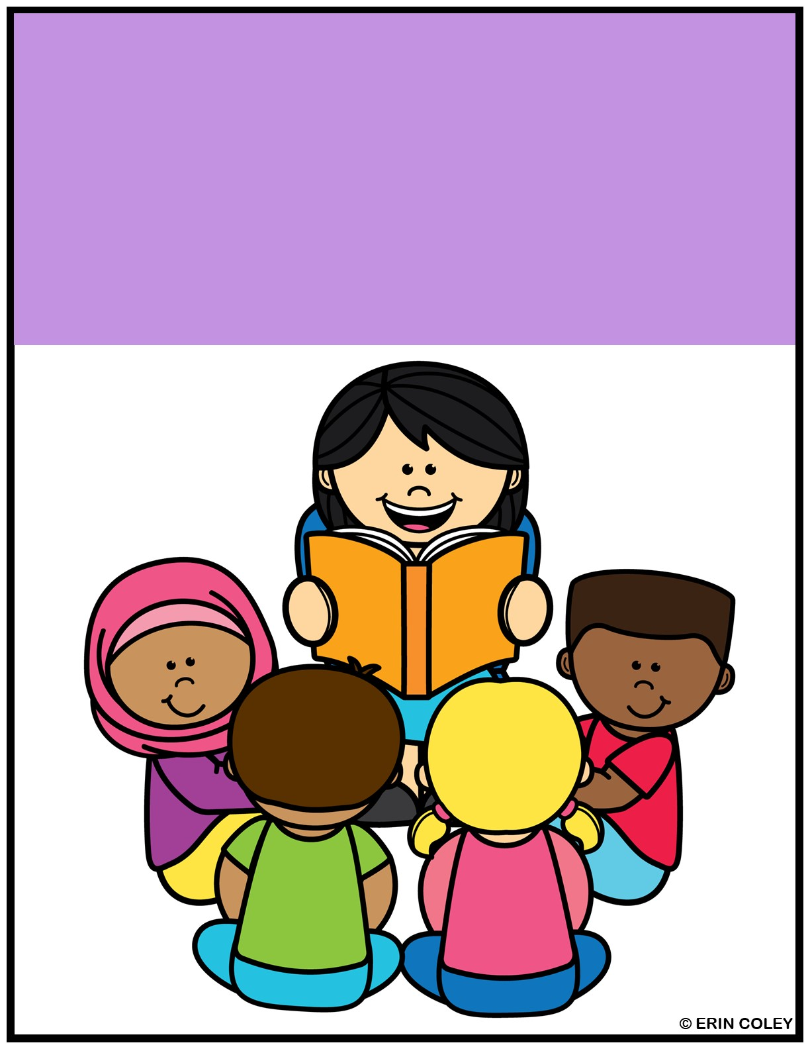
READ WITH TEACHER

Slide 9
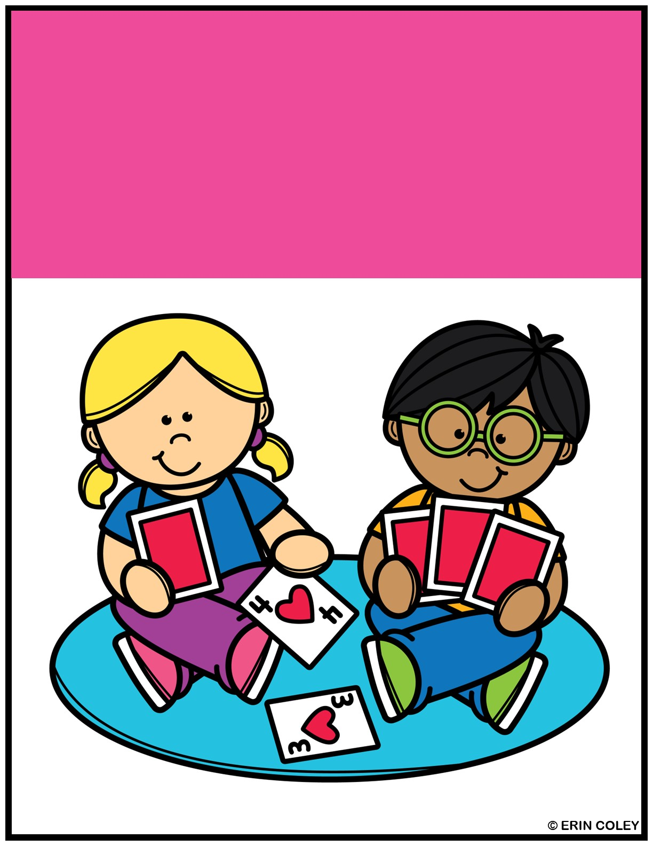
Math games

Slide 10
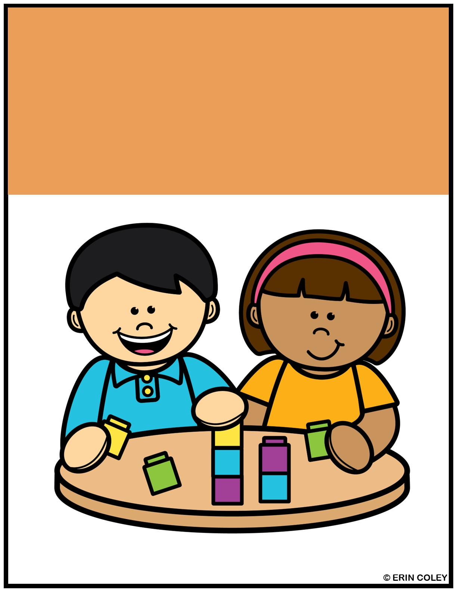
MATH WITH A FRIEND

Slide 11
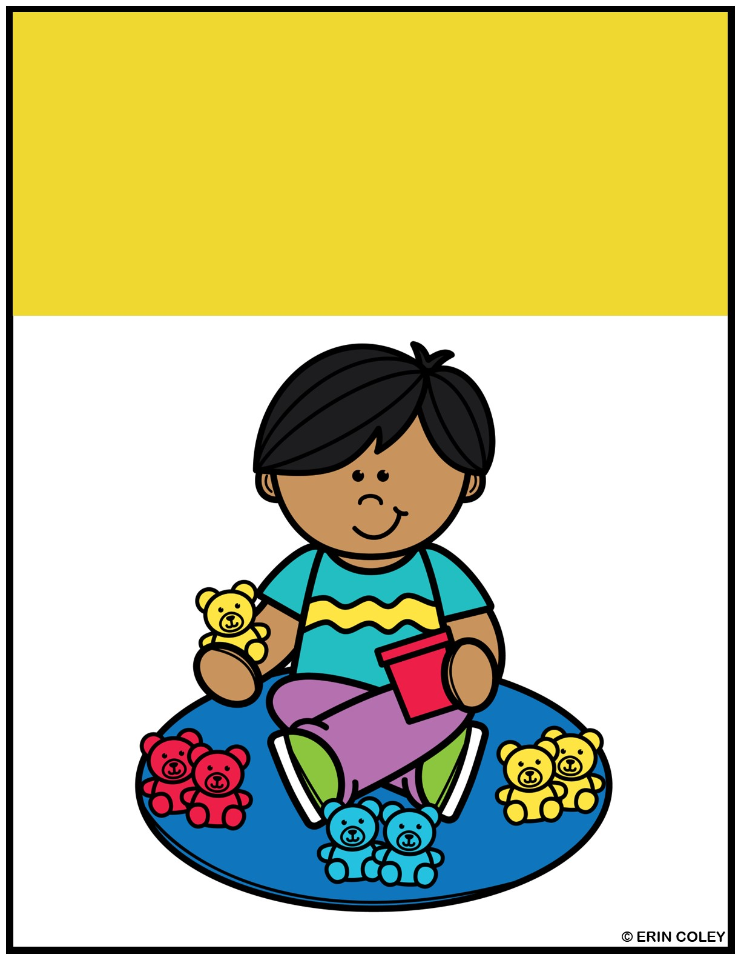
Sorting activities

Slide 12
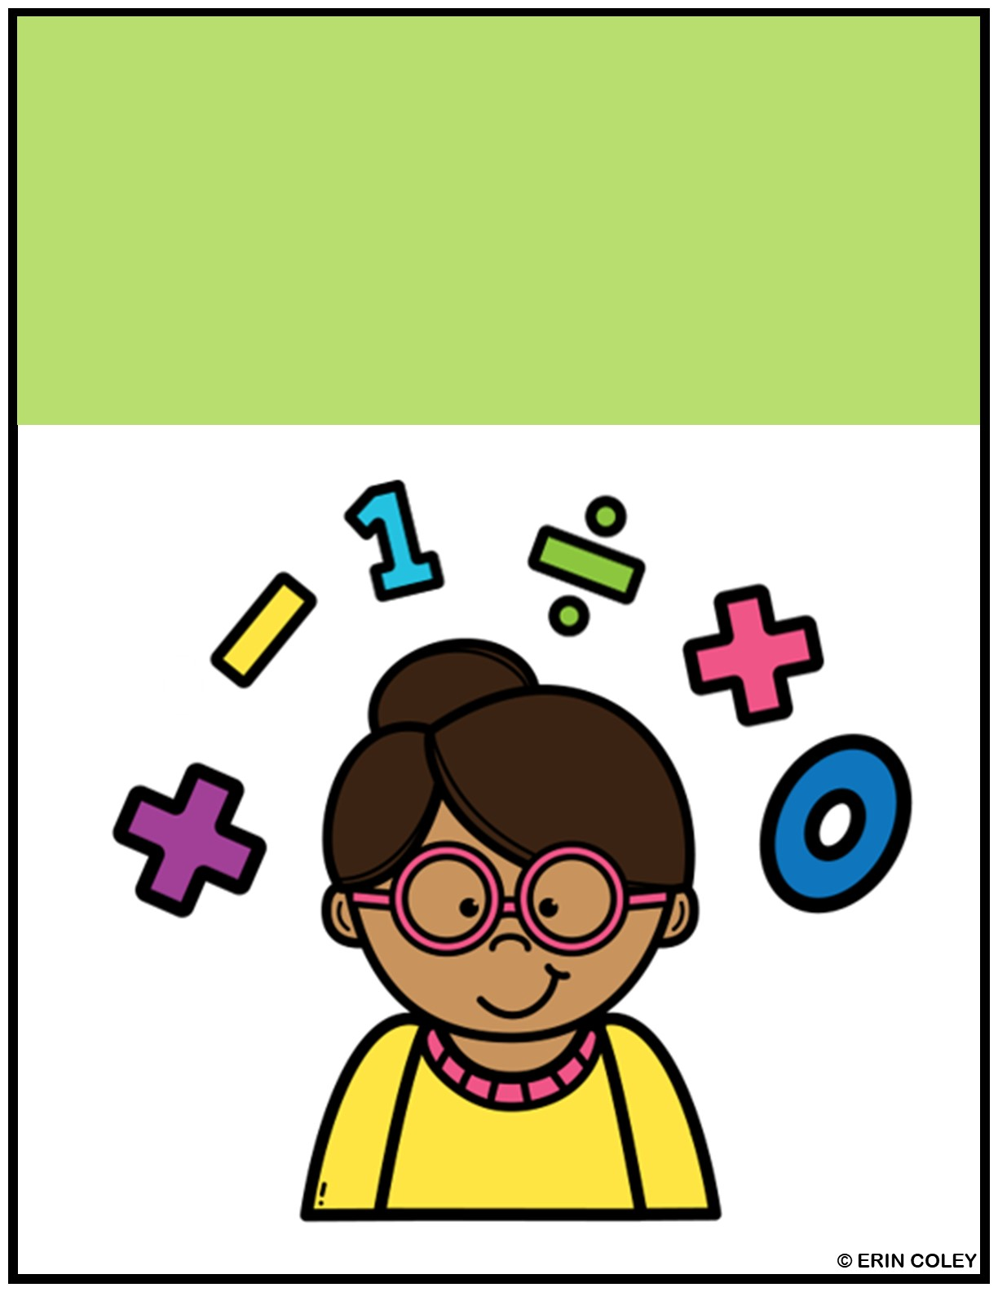
MATH WITH TEACHER

Slide 13
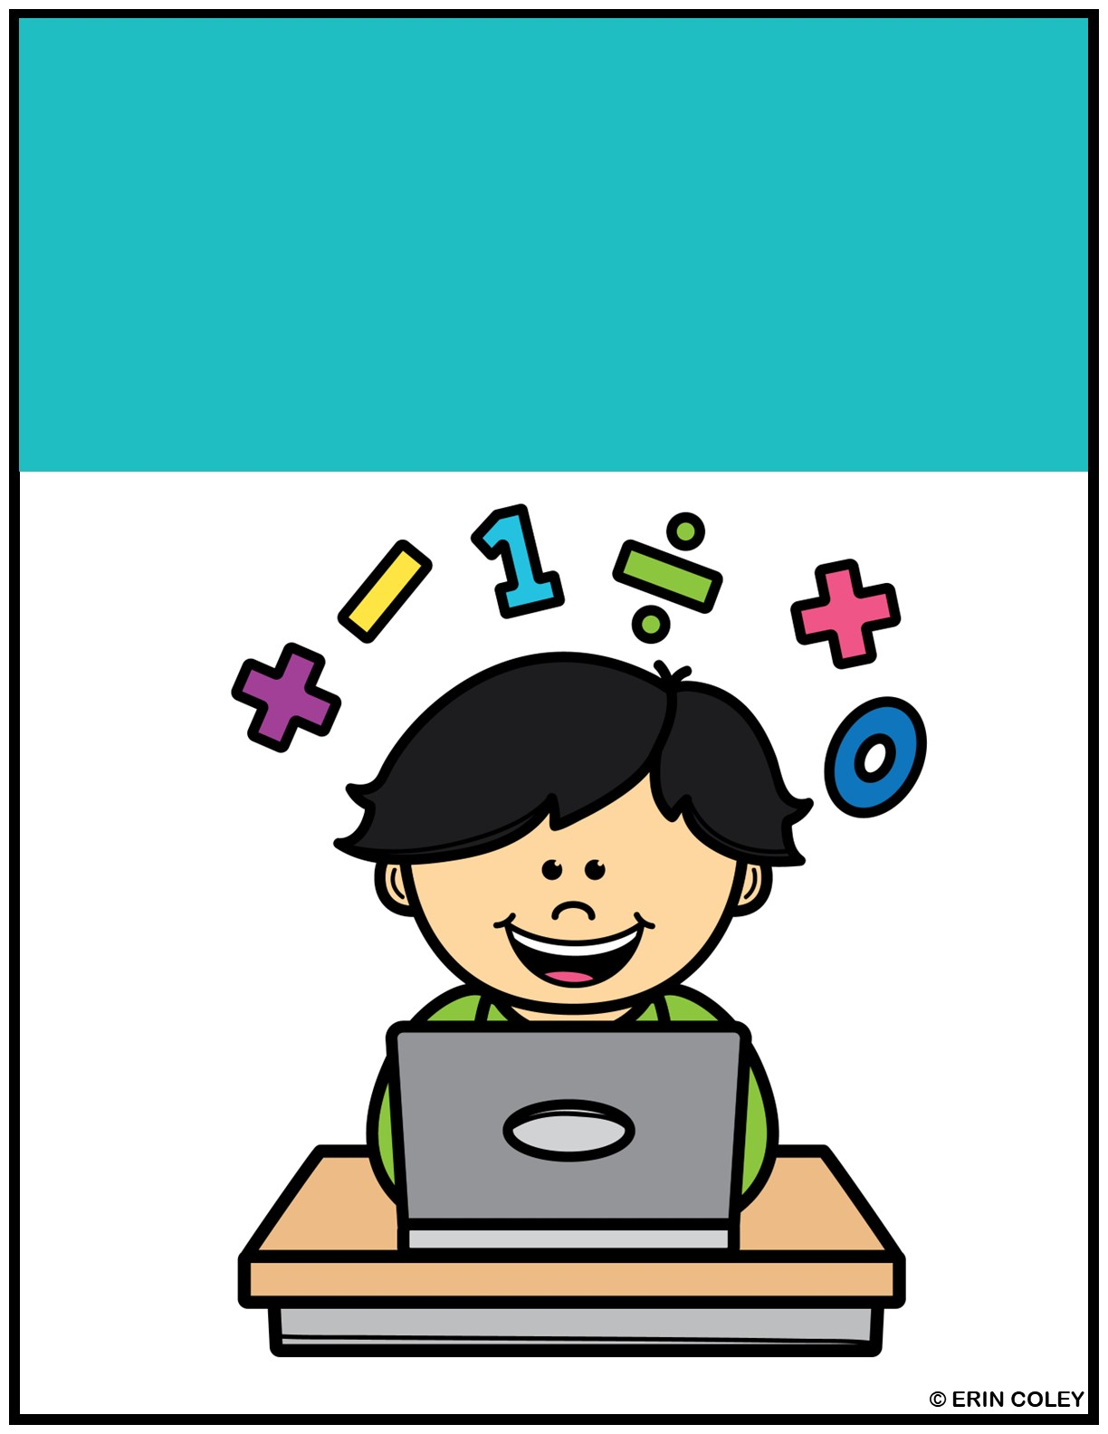
Math on computers

Slide 14
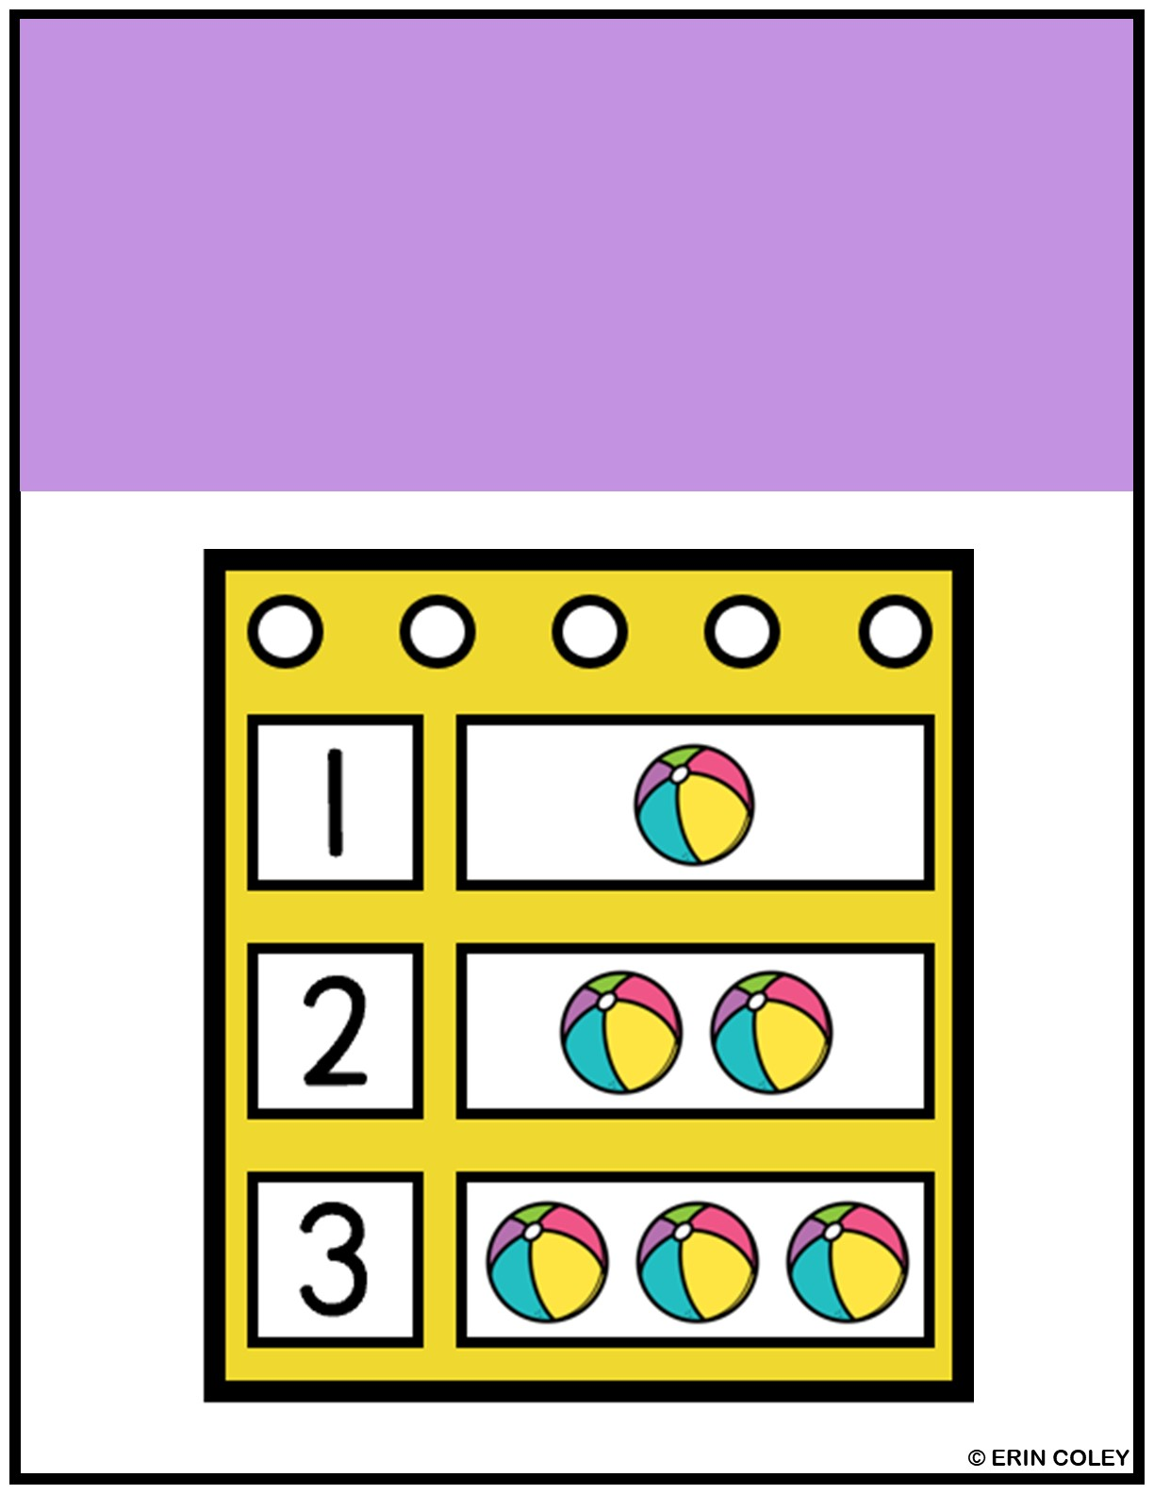
Pocket chart

Slide 15


